Slide 1

Final Project Analysis of YouTube Dataset Group D5

Slide 2
Introduction to YouTube Dataset
Data collected 10 countries for 8 months after November 14th in 2017.
Mitchell collected this data. The total size of the data is 516 MB.
The link to data sources is https://github.com/mitchelljy/Trending-YouTube-Scraper.
17 feature columns: video_id, tags, views, likes…
Description of the Data
380318 records. collected for nearly 8 months.
Every day 0.4 million hours of video are uploaded
Why is this a Big Data?

Slide 3
Problem Statement
Problem 1
What is the trend of the five most popular categories in each country?
Problem 2
What is the difference among total likes for the same video_ids across various countries?
Problem 3
What are the most frequent keywords in video descriptions for the three English-speaking countries (US, GB, CA)?
Problem 4
How do total sentiment scores for the ten countries differ from each other?

Slide 4
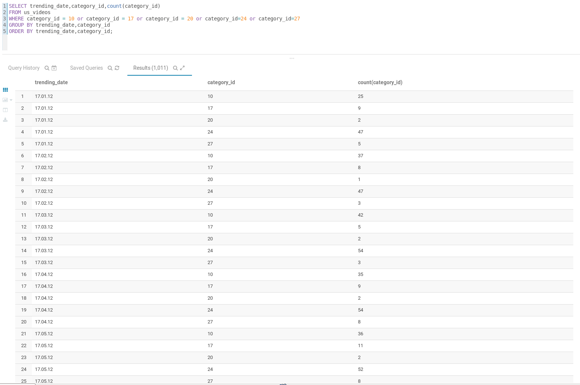
Data Processing

Slide 5
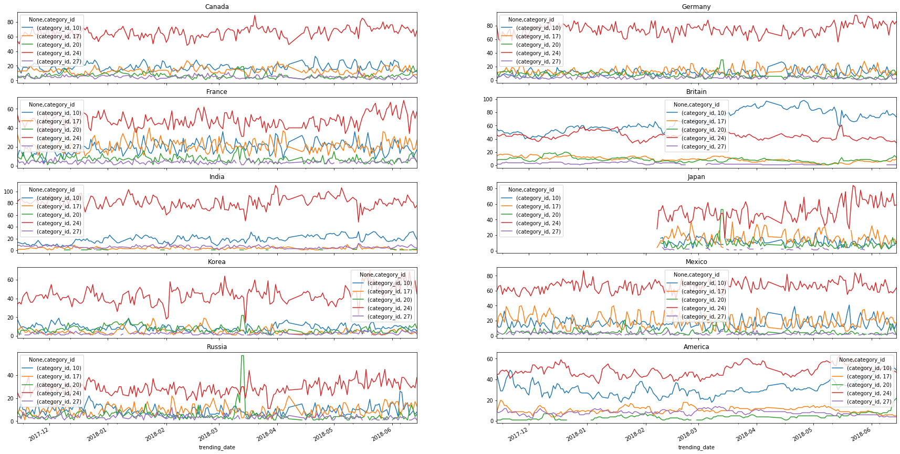
Category Analysis
Worldwide
10: Music
17: Sports
20: Gaming
24: Entertainment
27: Education
The entertainment category dominates other categories in most countries.
The British people really like music.
Sports, Gaming and Education categories are not as popular as the other two categories in all the countries.

Slide 6
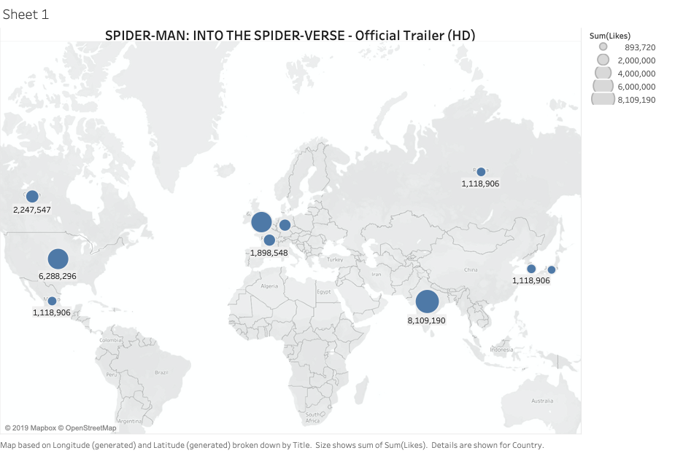
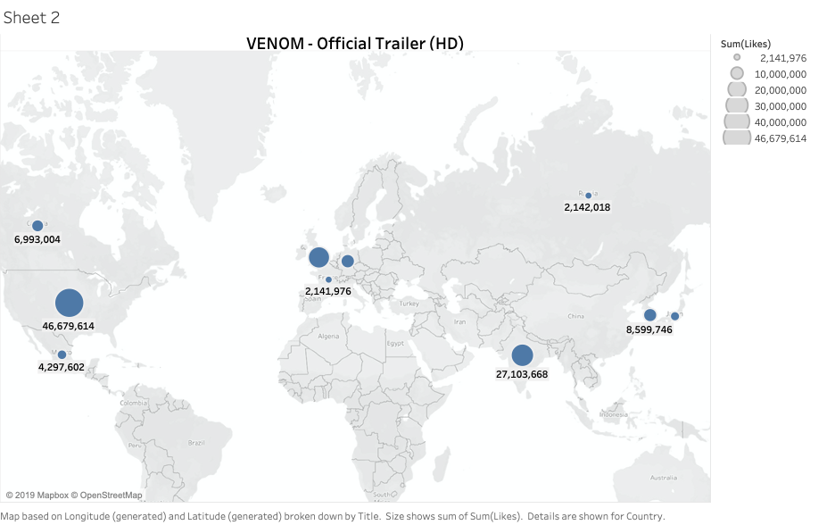
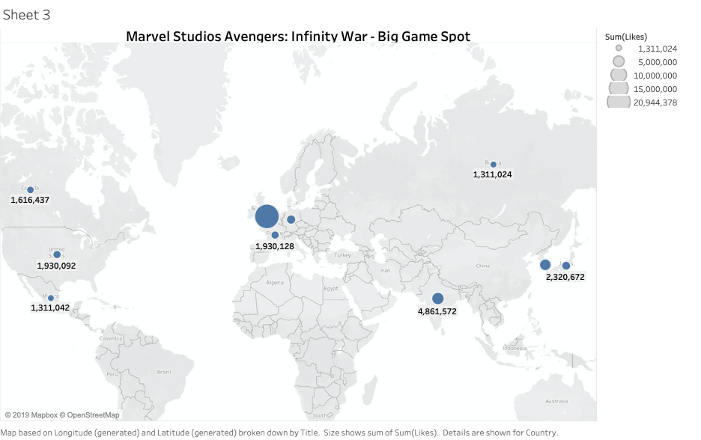
Difference among total likes for same videos across countries

Slide 7
Key Words in Description
- by looking at three English-speaking countries

Slide 8

GB WordCloud
US WordCloud
CA WordCloud

Slide 9

GB WordCloud
US WordCloud
CA WordCloud

Slide 10

GB WordCloud
US WordCloud
CA WordCloud

Slide 11
Sentiment Analysis
- by calculating total sentiment scores

Slide 12
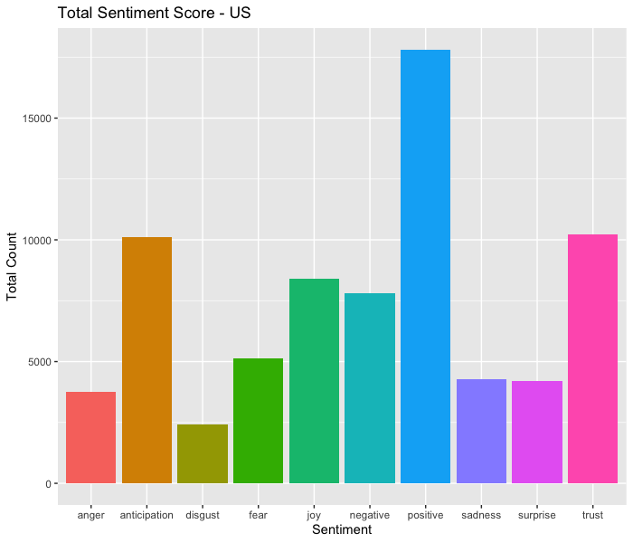
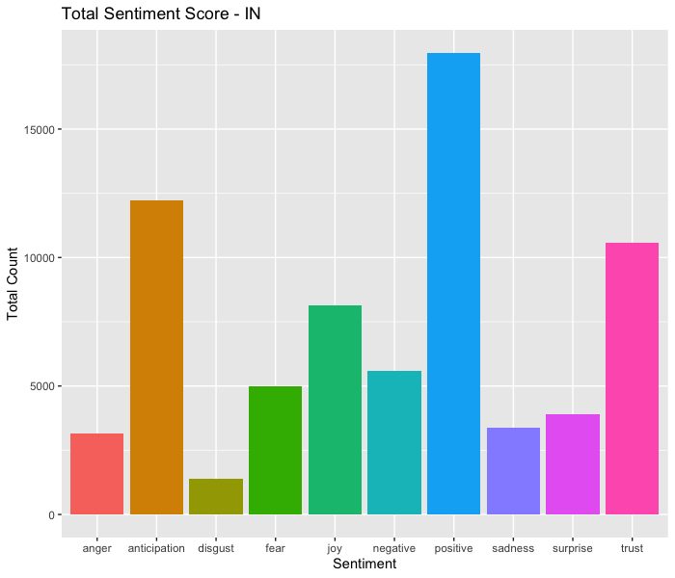

Highest Score Group
Lowest Score Group
Interesting Finding

Slide 13
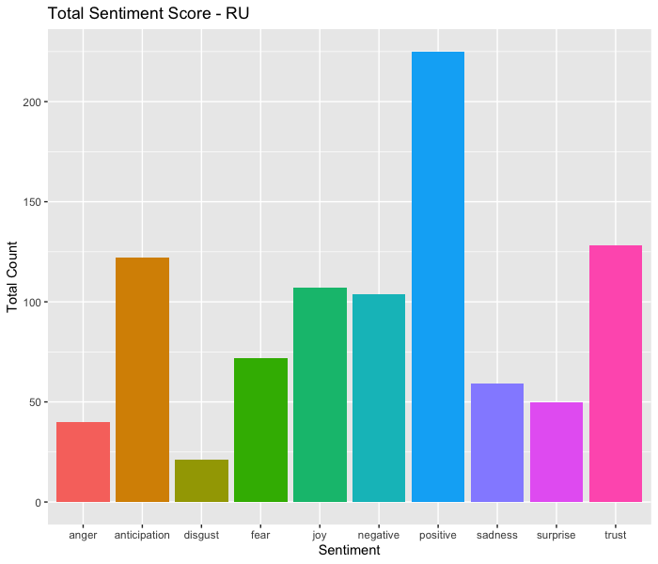
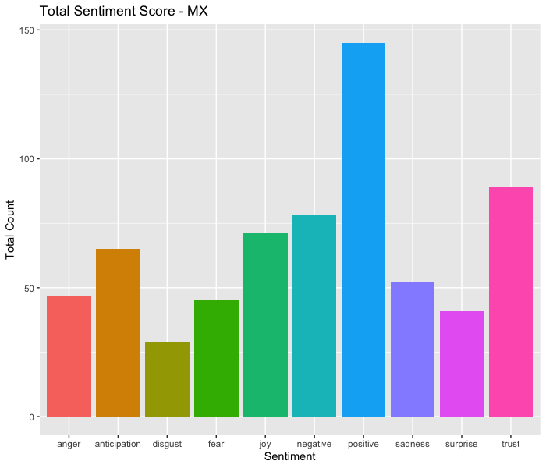
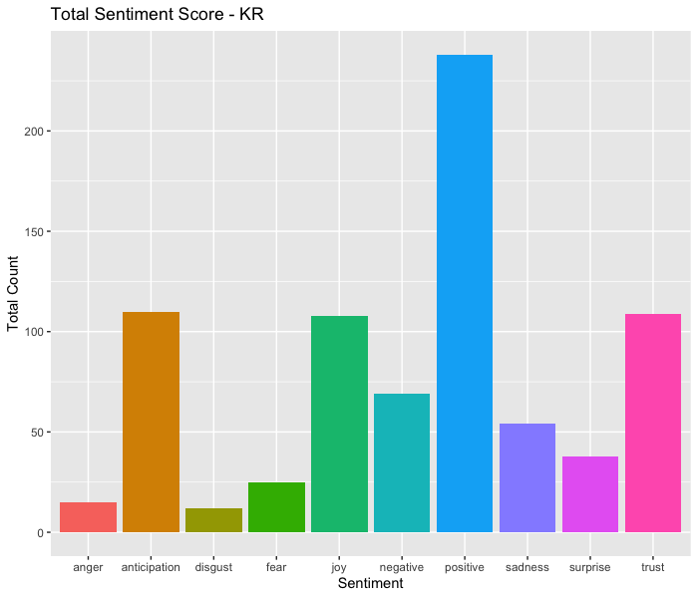
Highest Score Group
Lowest Score Group
Interesting Finding

Slide 14
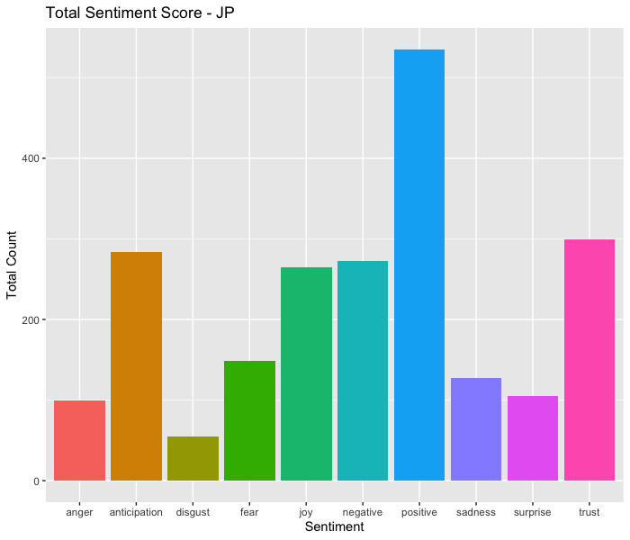


Highest Score Group
Lowest Score Group
Interesting Finding
MX
JP
$$\text{“}\text{negative}\text{” > “}\text{joy}\text{”}$$
$$\text{“}\text{negative}\text{” > “}\text{joy}\text{”}$$

Slide 15
Conclusion
From the perspective of the YouTube platform:
National conditions
From the perspective of users:
Learn new knowledge
Suggestions
From the perspective of the dataset:
More interesting results.
From the perspective of methods:
Further meaningful research like using statistical models.
Further improvements

